Slide 1

Indicater Placement Presentation 2014-15

Slide 2

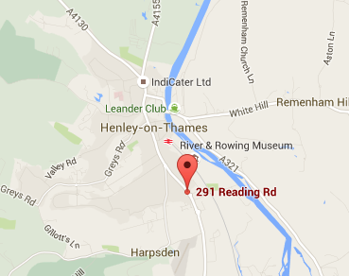


About Indicater
Mike Day
CEO
Lou Wilcock
Founder and Director
Based in Henley
Established in 2000 by mike day and Lou Wilcock
Delivers business management solutions for the hospitality industry
Provides web-based back of house online management systems for business operations such as payroll, sales, patient dining, online booking
Offering over 30 modules of critical business management tools

Slide 3















About Indicater
Providing software solutions for over 2500+ outlets
Good business relations in hospitality industry
Clients
Partners

Slide 4
Job Role and Responsibilities

Slide 5
Adding Value

Slide 6
Evaluation

Slide 7
Positives and Negatives

